Slide 1
.NET in every program
James Montemagno
@JamesMontemagno
https://mono.github.io/Embeddinator-4000/
Weekly Dev Podcast
mergeconflict.fm

Slide 2




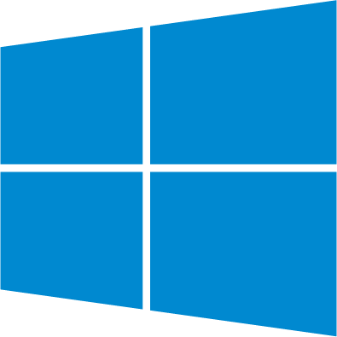
Native Clients in C#: Mobile, Mac, & Windows
.NET goes to every single client platform
Android C#
macOS C#
iOS C#
tvOS C#
Linux C#
Windows C#
Web
Shared C# Logic

Slide 3
Embeddinator-4000
There are existing codebases in ObjC, Java, Swift, C++.
How could you reuse all the .NET greatness there?
All those amazing libraries
Do you give up your NuGet addiction?
Do you start from scratch?
Do you switch industries?
Do you re-evaluate your life choices?
You do not need to!

Slide 4
Turns any .NET library into a native library
Android Java
macOS Objective-C
iOS Swift
tvOS Swift
Linux C++
Jar
DynamicLib
Framework
Framework
C++
Shared C#/.NET Logic

Slide 5
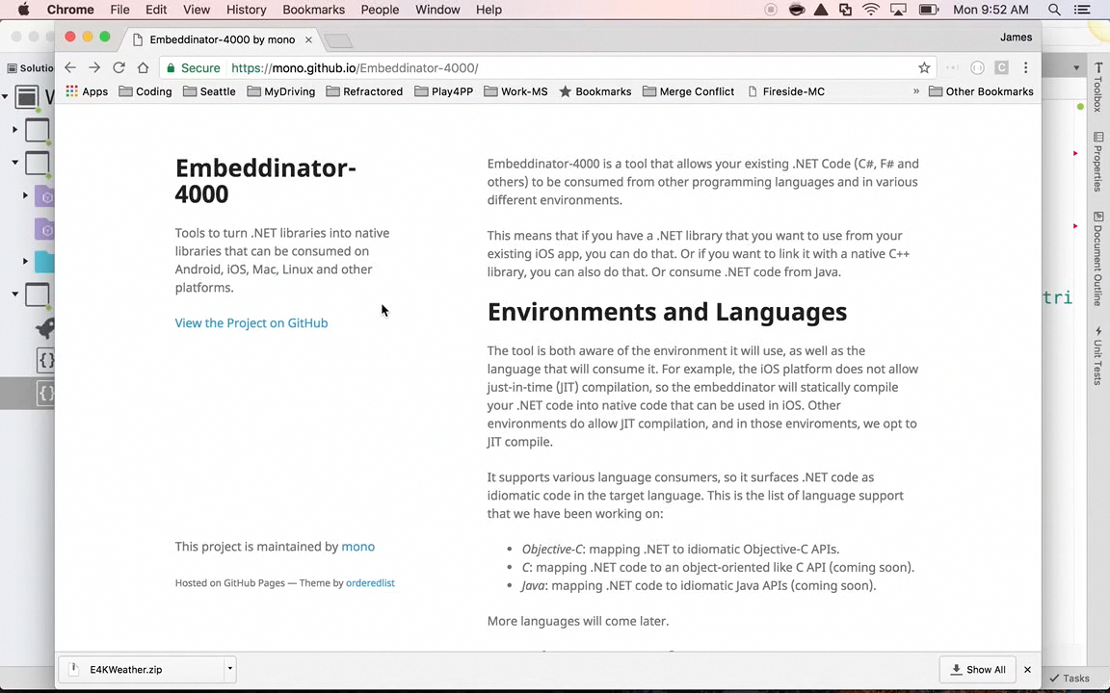

Slide 6
.NET in every program
James Montemagno
@JamesMontemagno
https://mono.github.io/Embeddinator-4000/
Weekly Dev Podcast
mergeconflict.fm

